Slide 1
Sustainable TECH
BMS3105
2025-10-28
Damon Hart-Davis

Slide 2
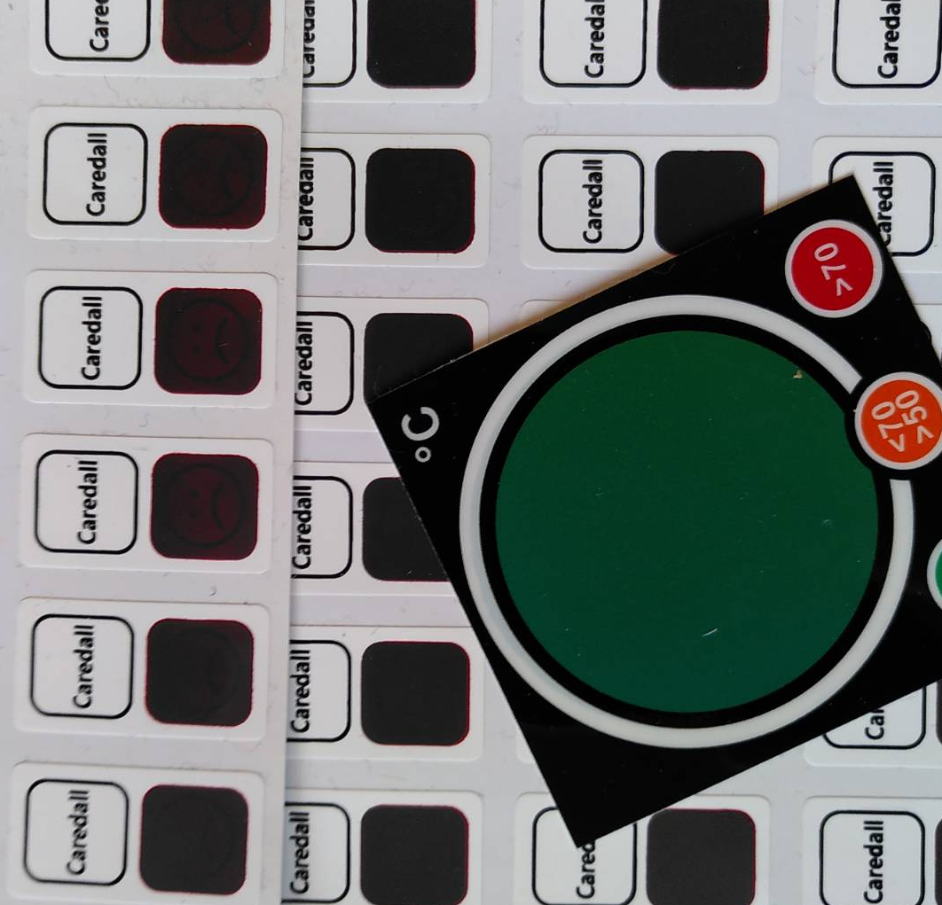
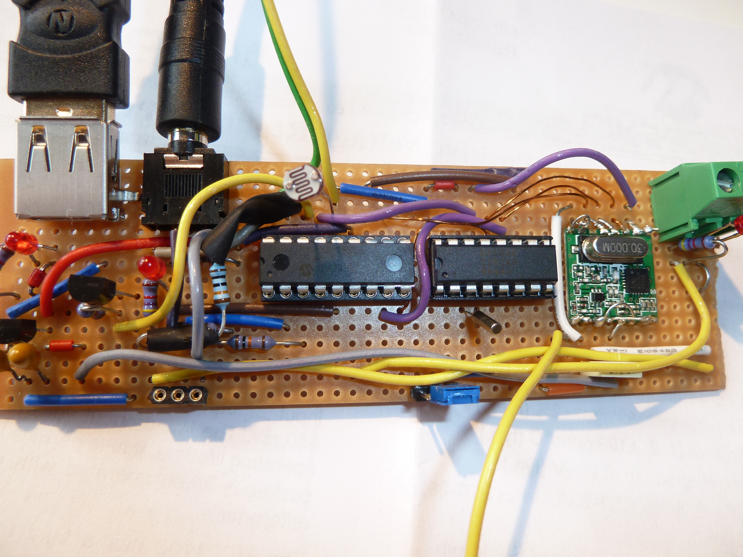
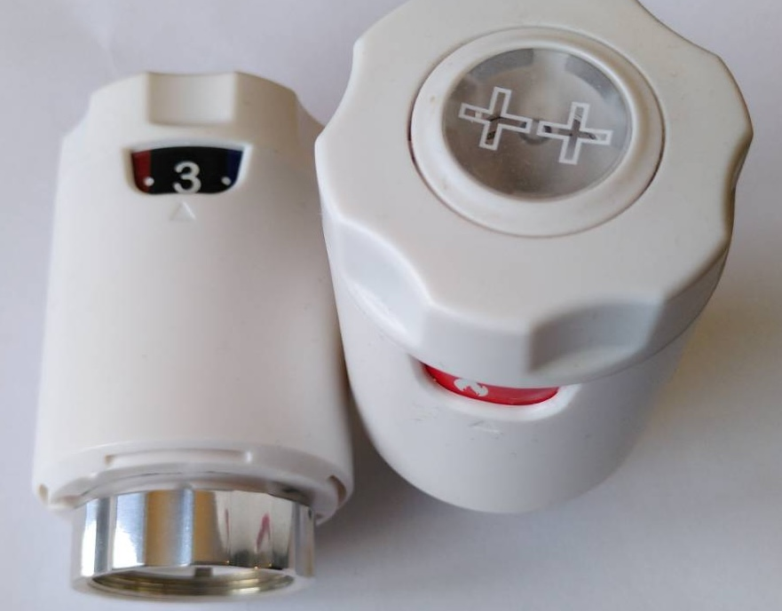
SUSTAINABLE TECHNOLOGY
THIS?

Slide 3
What'S IT ALL ABOUT?
Sustainable technologies and innovation
“... negative impacts of humans on the environment and ways to mitigate ...”
DISCUSS points to help keep us all awake
Stop me as I go with questions, existential or otherwise!

Slide 4



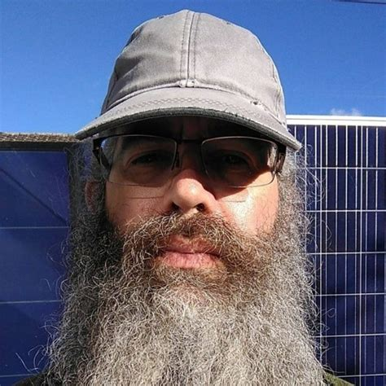

ME ME ME!
Semi-retired serial entrepreneur, not quite as rich as Croesus or Musk
Brought several technologies to market, probably good for the environment overall
Run environmental and inventor groups
Researching sustainability PhD
Occasional raver!

Slide 5
WHAT IS "SUSTAINABLE TECHNOLOGY?"
  New (cancer cures, green revolution)?
  Essential, done better (EV, heating, insulation)?
  New, reducing demand elsewhere (Internet vs travel, physical paperwork, cashless payment)?
  Exotic, mega-scale (CCS, space umbrellas)?
  DISCUSS

Slide 6
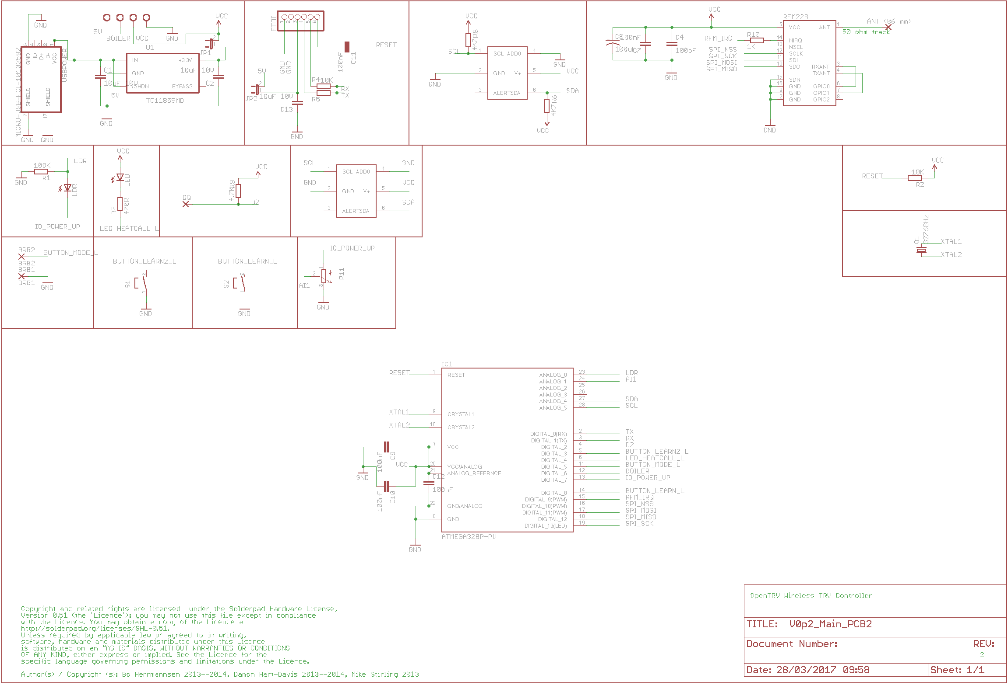

DISCUSSION
WHAT IS SUSTECH?
In groups please pick one example each of tech new or old that is or is not "sustainable" and justify why...

Slide 7
Was My Tech Sustainable?
  ExNet early UK Internet Service Provider (~1995)
  Entropay virtual VISA payment card (~2003)
  OpenTRV/Radbot heating control (~2020)
  PhD in decarbonising home heating (now)
  (Don’t talk about defence, oil, banking!)

Slide 8
Motivators Affect SUSTAINABILITY?
  Getting rich?
  Making the world better?
  Doing interesting things?
  Retiring early (FIRE)?

Slide 9
HEALTH vs POLLUTION
  ‘Wealth’ / happiness / healthspan can be decoupled from environmental damage
  We can probably deal with climate change, microplastics, biodiversity and peaking populations AND be happier, if wise
  (Sun-following Web servers?) [piantella2025harvesting]
  Tech AND behavioural change can enable this
  DISCUSS

Slide 10
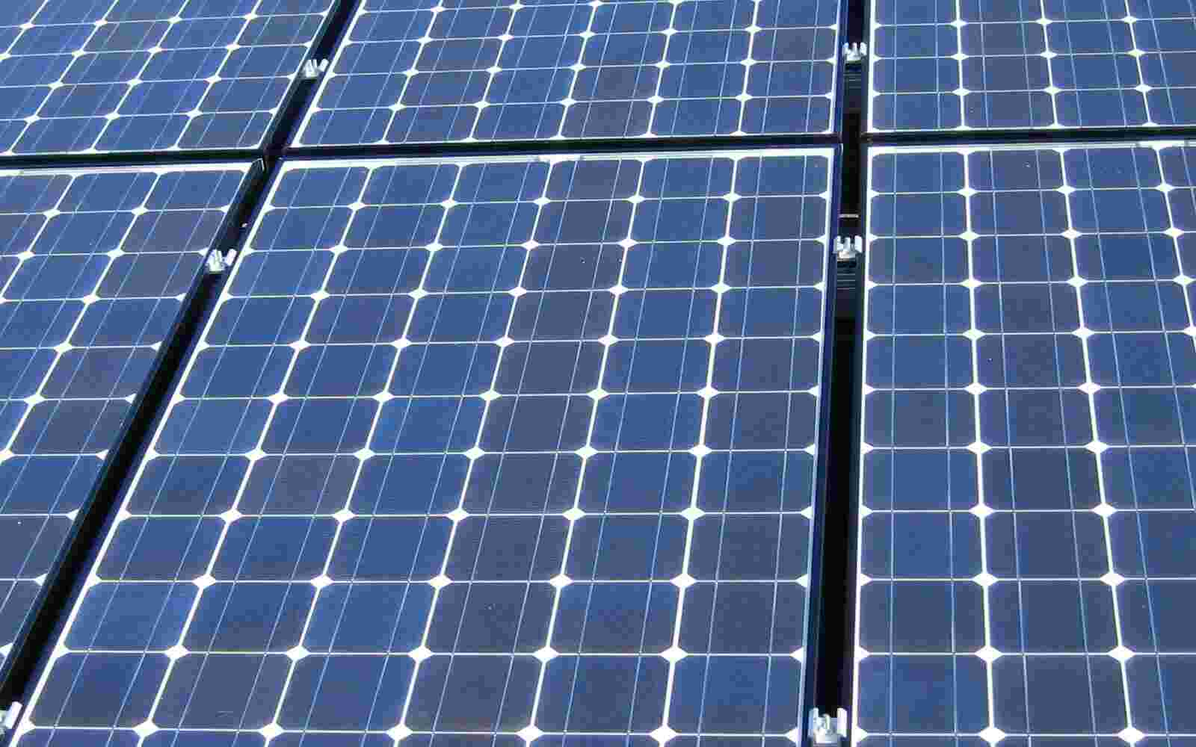
DISCUSSION
Tech fixes
In groups please discuss and decide if we can fix our current polycrisis with just a bit more tech, or if not, what else should be in the mix?

Slide 11
AI LLM Brouhaha!
  Any opinions on the current ‘AI’ fuss?
  Anyone heard of ‘AI winter(s)'?
  Energy consumption a huge concern
  AI-generated a video promo that I could not have created in real life [hart-davis2025promo]
  Ethical because promoting climate-fixing site?
  DISCUSS

Slide 12
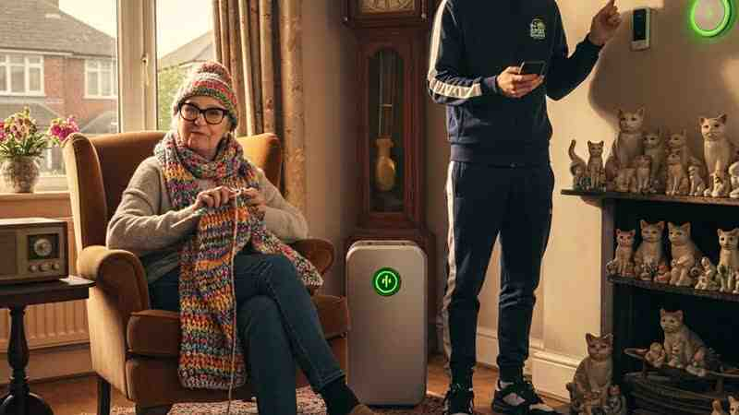
DISCUSSION
AI – mate or menace?
In groups please discuss and decide if AI is all good or all bad or something more complicated...

Slide 13
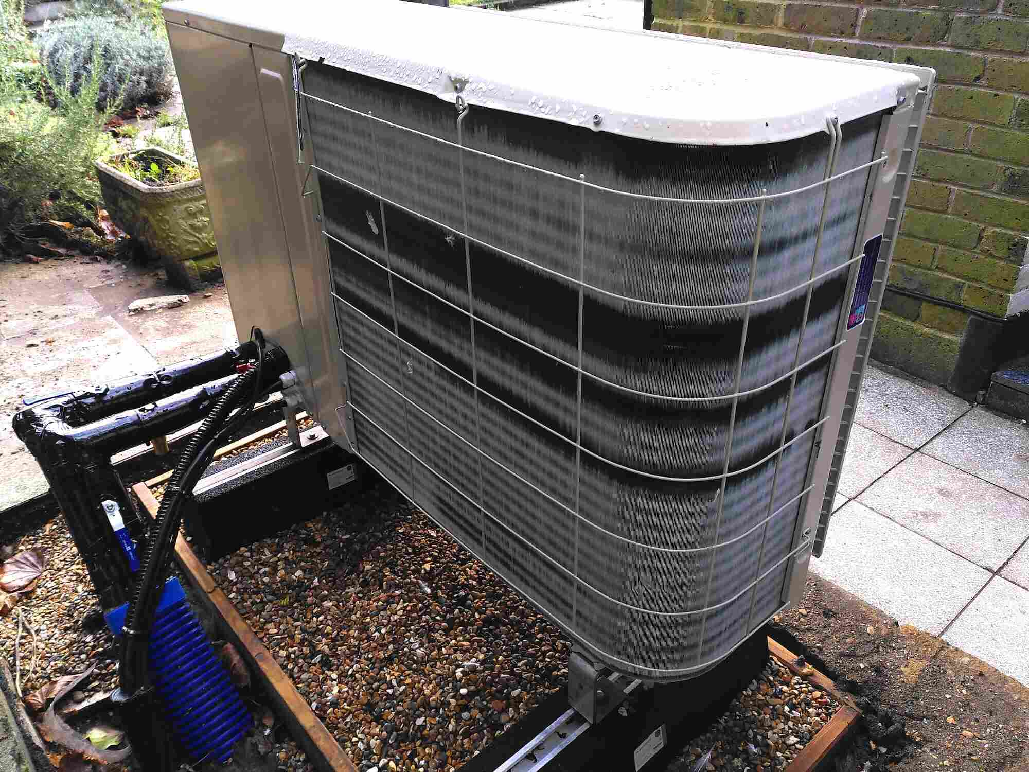
UK HOME HEATING DECARBONISATION
  Heat pumps are well over 100 years old!
  Cf fridges, not good at installing in homes
  I aim to fix this, and have householders understand heat pumps better than gas!
  ~20M UK home gas boilers need retrofitting with heat pumps by 2050
  Eliminate ~15% UK GHGs: very sustainable!

Slide 14
TRVs and MICROZONING
  One weird trick saves ~15% of carbon footprint (and heating costs) in home retrofits... [hart-davis2024zone]
  Have just run an experiment in a whole house inside a lab in Salford to demonstrate
  Later in my research I hope to help people run their house heating with house music!

Slide 15
No one's going to do anything about it. The planet won't be saved. It wouldn't be cost effective to do so.
Kurt VonneguT (1989)

Slide 16
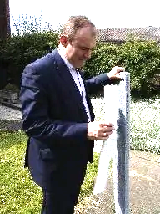
Sunshields IN SPACE vs Sufficiency
  Do we have enough tech to fix the climate?
  Or sunshields, particulates, polar whitening...
  Or fewer flights, fewer cars, less stuff?
  My small home described by energy minister as 'modest' vs RIBA 'rabbit hutch' - but Net Zero! [mark2015homewise]
  Keep innovating, be frugal!
  DISCUSS

Slide 17
DISCUSSION
Enough?
In groups please discuss and decide whether you think we already have all the tech we need to fix at least climate change...

Slide 18
ALL DONE!
  Thank you!
  Questions?
  These slides are available on my site [hart-davis2025sustech] and on SurreyLearn...
  © Damon Hart-Davis 2025 CC-BY-4.0

Slide 20
References
[hart-davis2024zone] Hart-Davis, Damon and Liu, Lirong and Leach, Matthew To Zone or Not to Zone When Upgrading a Wet Heating System from Gas to Heat Pump for Maximum Climate Impact: A UK View 2024-05-31, Sustainability, volume 16, report/number 11, ISSN 2071-1050, doi:10.3390/su16114710
[hart-davis2025promo] Hart-Davis, Damon AI Promo Rap Style Video 2025-10-13
[hart-davis2025sustech] Hart-Davis, Damon Sustainable Tech 2025-10-28 (this slide deck)
[mark2015homewise] Laura Mark RIBA: UK homes are still too small 2015-12-03, Architects' Journal
[piantella2025harvesting] Benedetta Piantella and Syeda N. Anjum and Aakruti Lunia and Alex Nathanson and Tega Brain et al. Harvesting Light, Cultivating Care: Exploring Intermittence As Framework for Infrastructuring and Stewardship 2025-11, Proc. ACM Hum.-Comput. Interact., doi:10.1145/3757410
https://www.snopes.com/fact-check/kurt-vonnegut-society-quote/

