Slide 1
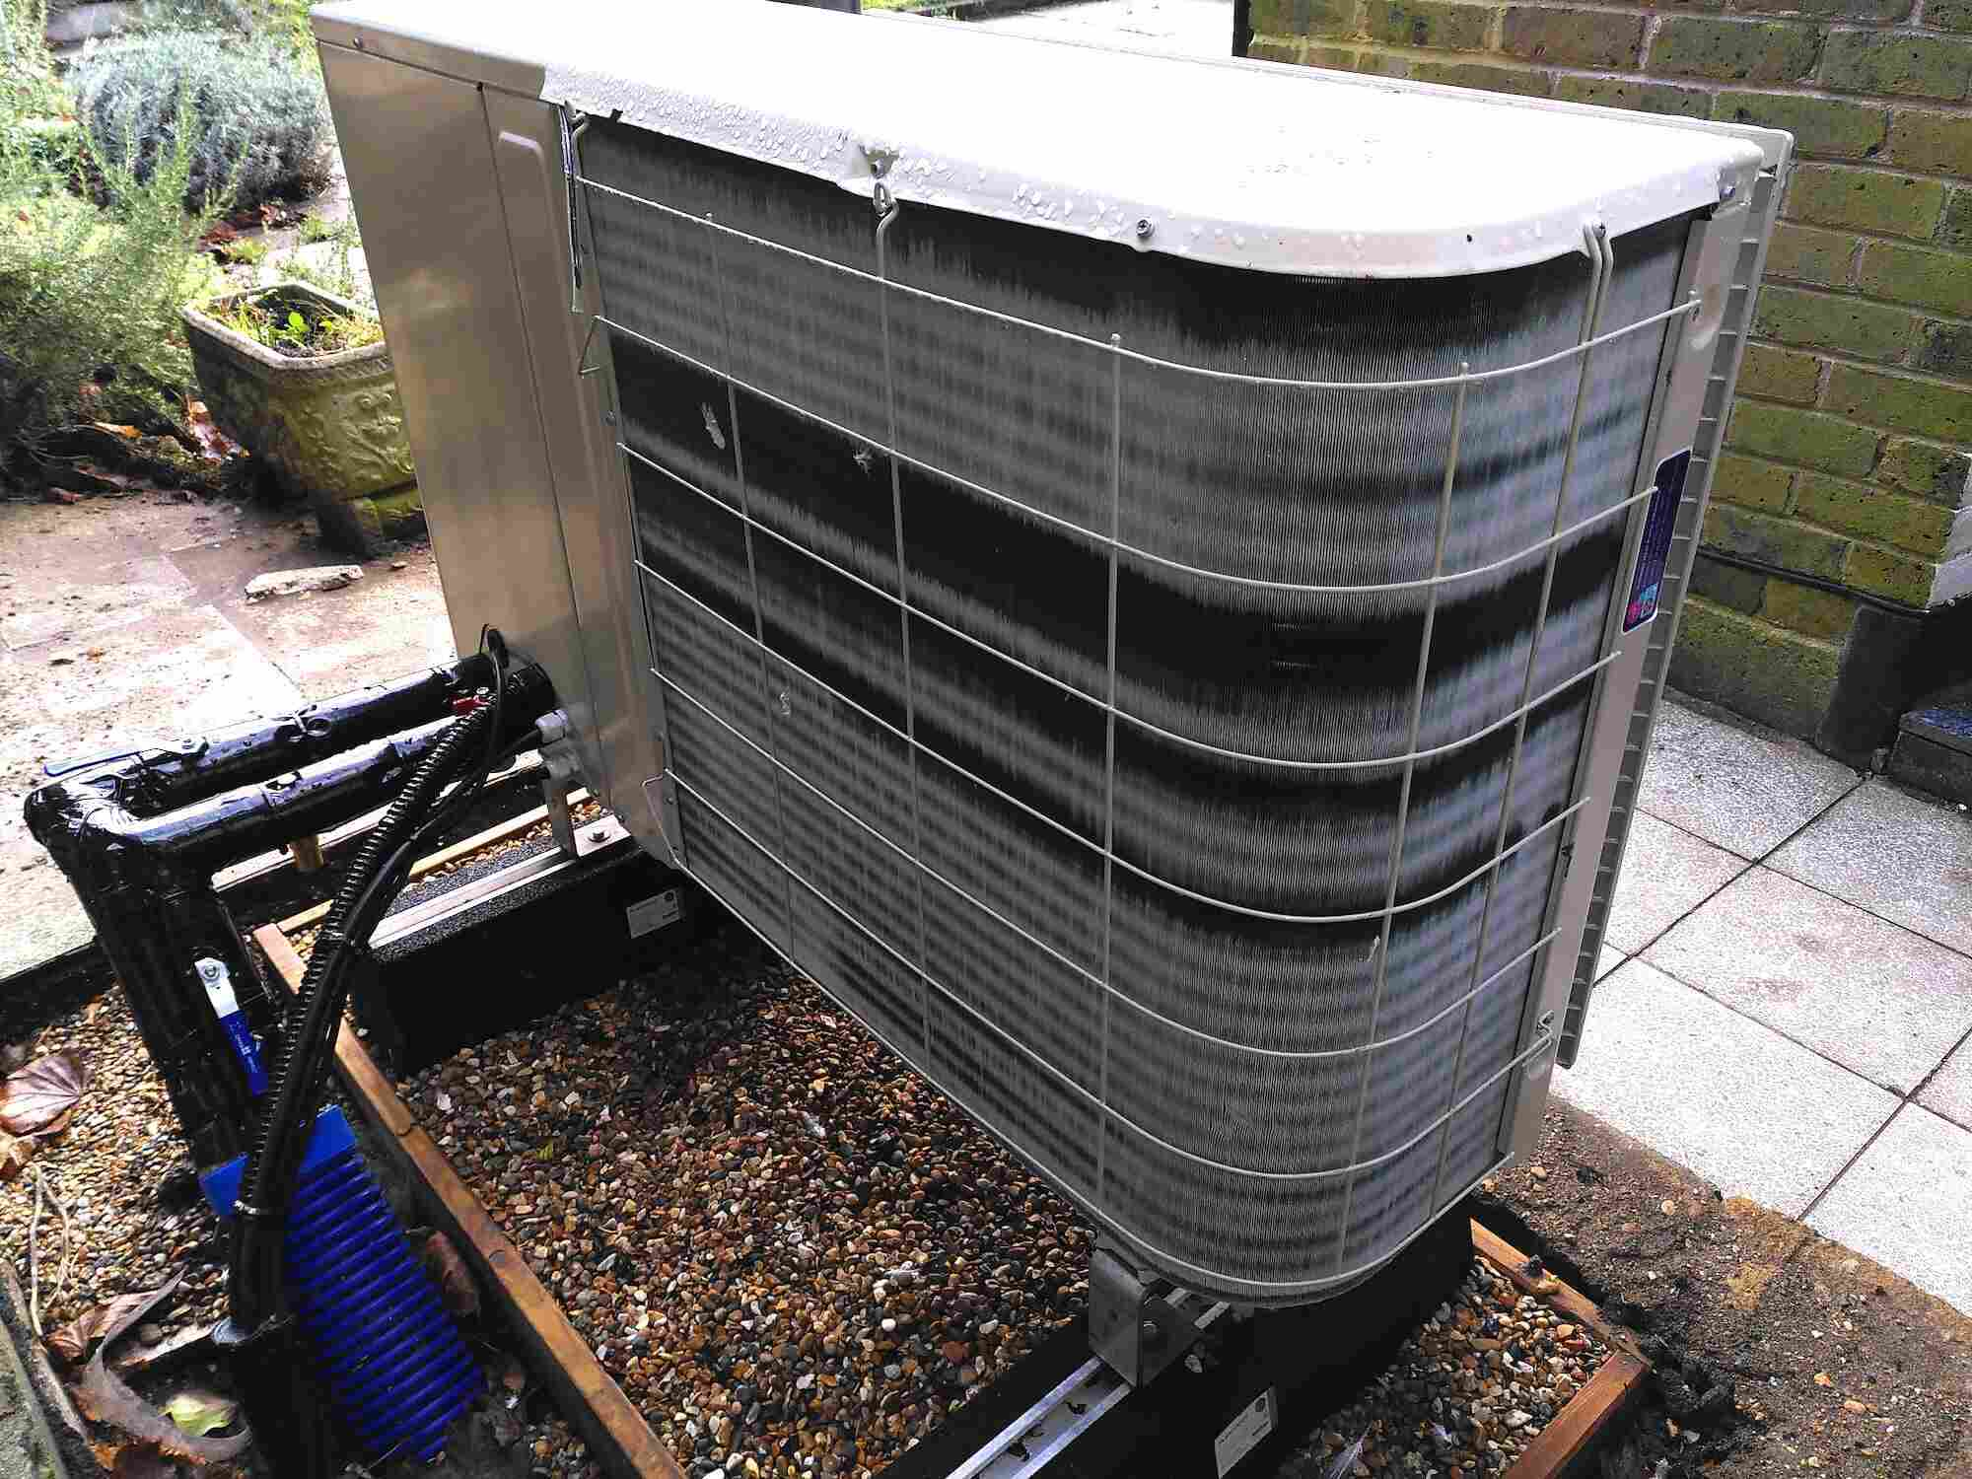
Greener UK Home Heating
Rhymes with Financial Derivatives!
Pint of Science 2026-05-18

Slide 2
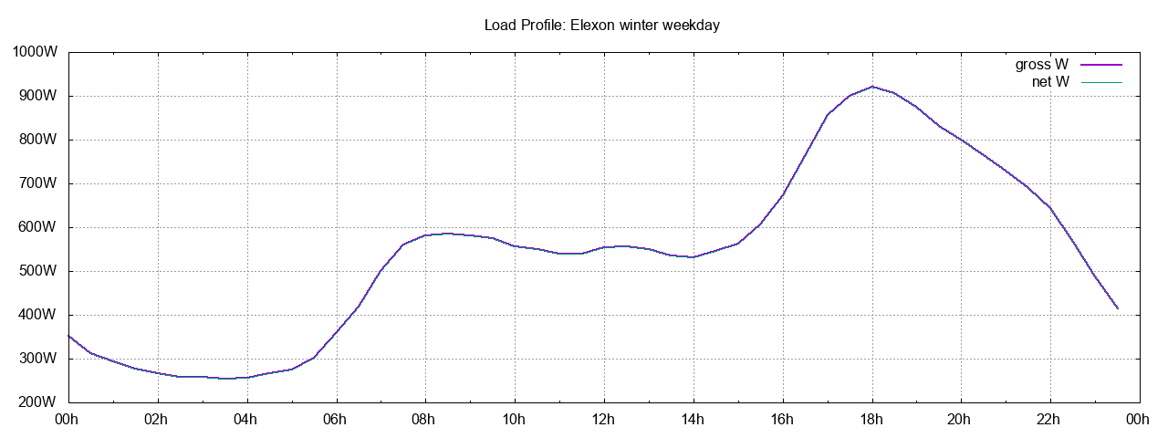
Introduction
History doesn't repeat, but sometimes rhymes
What fixing the climate can learn from finance
A take-home tweak that you could try tonight!
Damon Hart-Davis d.hart-davis@surrey.ac.uk
PhD research in decarbonising home heating
Previously: multiple startups, finance, AI&CS

Slide 3
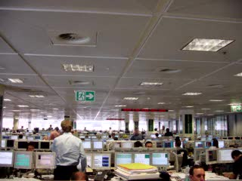
Distributed, Derivative, Decarbing
A long-term interest has been distributed computing systems, including the Internet (I created an early ISP) and grid (micro) renewables.
I spent a long time working in Fixed Income Derivatives in the City.
Insights from the two help decarbonise the country!

Slide 4
Home Heat Decarbonisation
To eliminate the ~15% of UK greenhouse gas emissions due to home heating most of us will move to heat pumps.
Electrifying heating will roughly double peak demands on the grid.
The grid has to be sized to meet peak demand — so flattening peaks saves lots of money!
But not everyone has to do the exact same thing to help fix the issue...

Slide 5
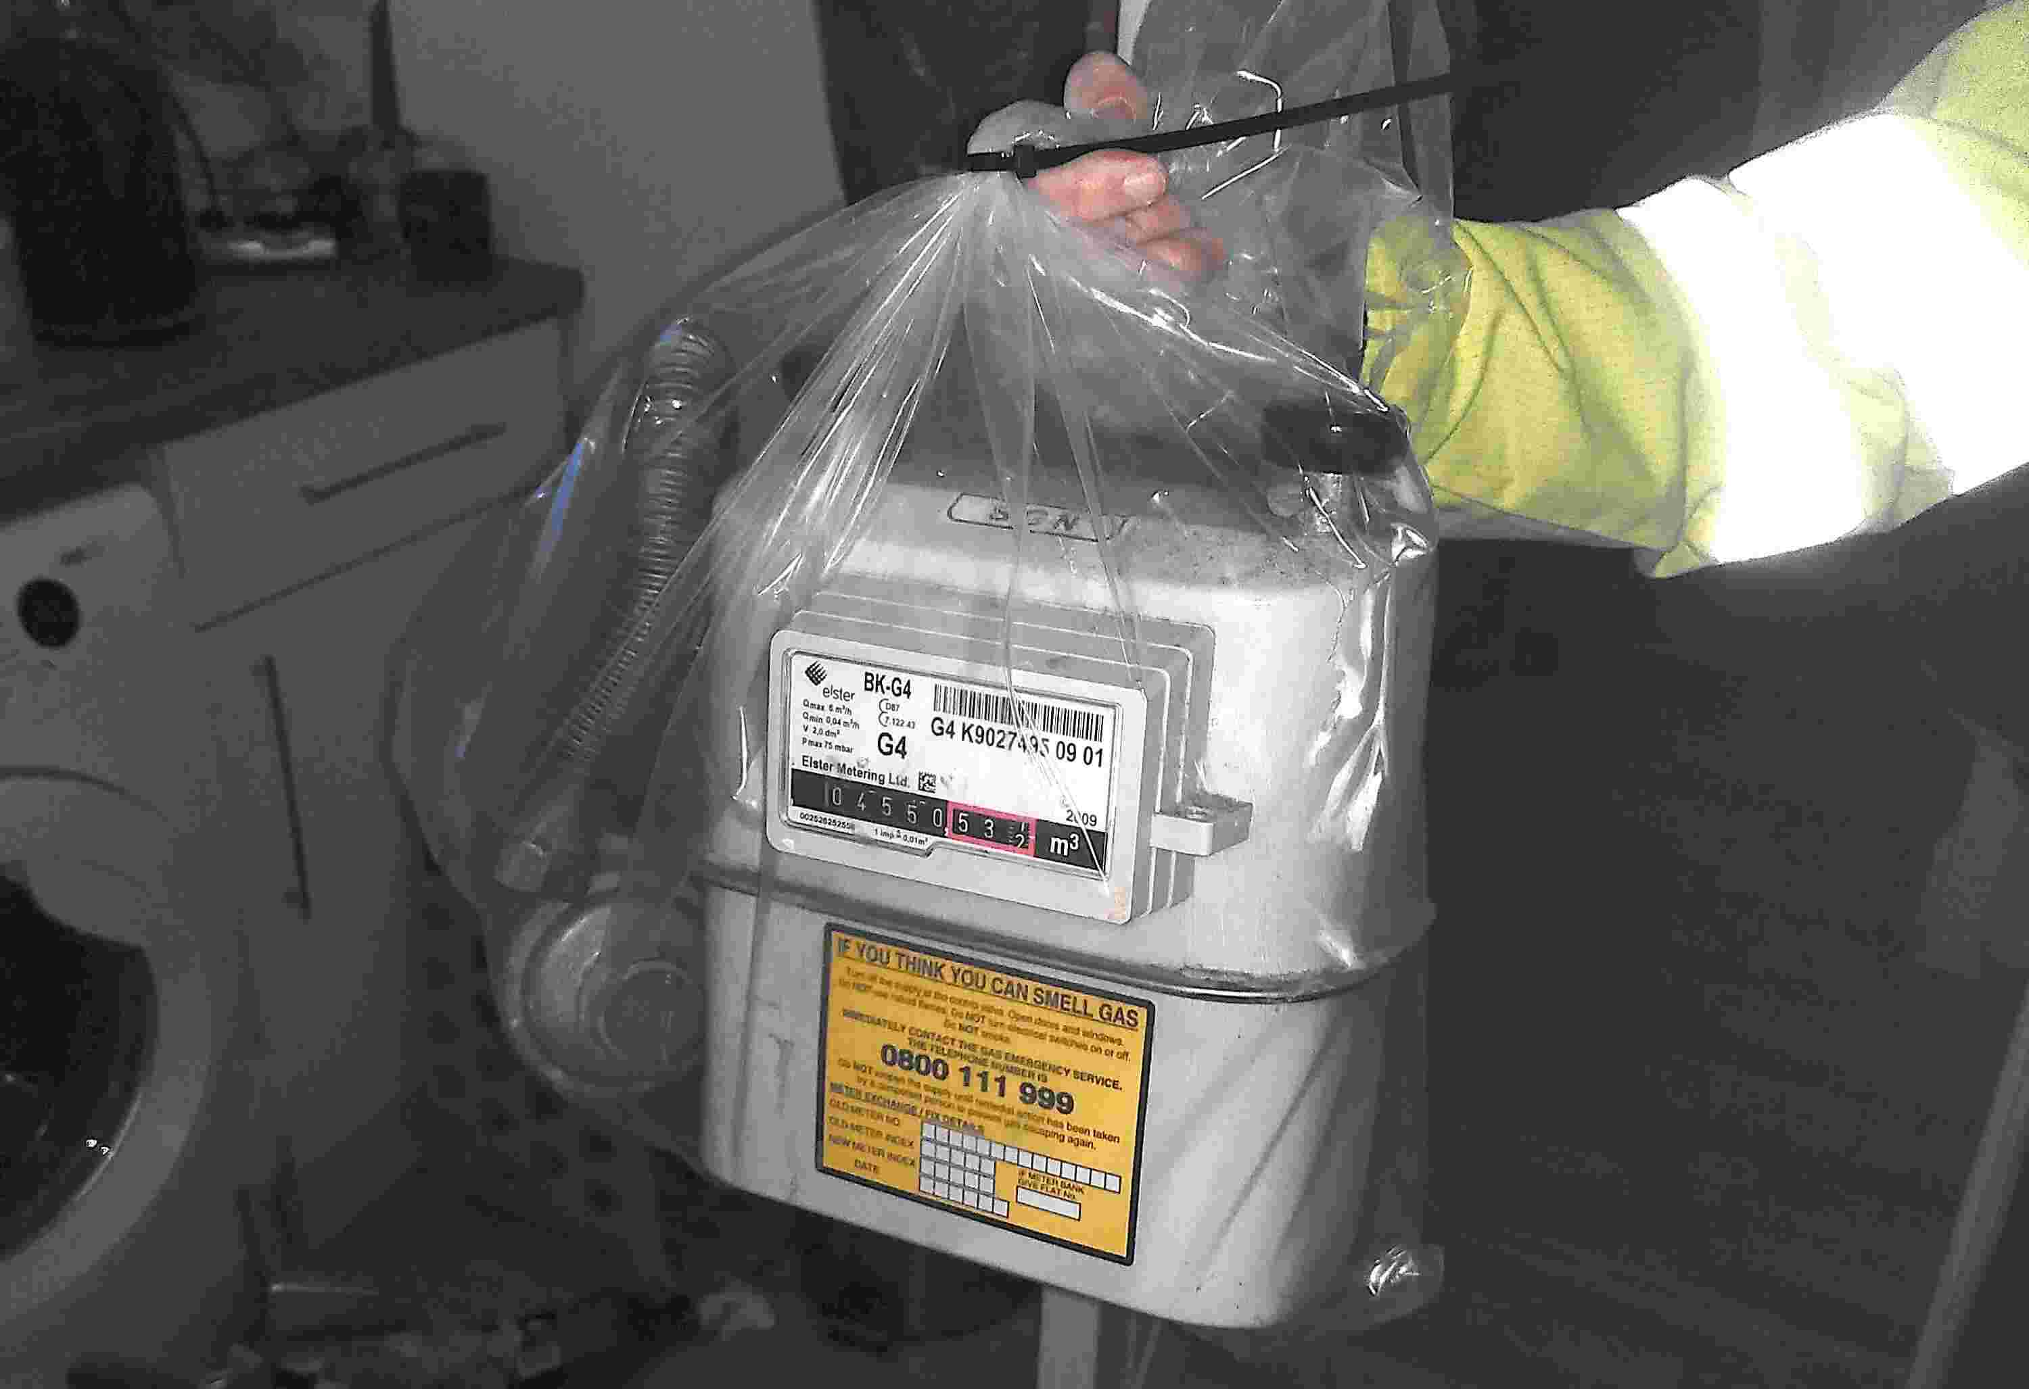
Cut Carbon, Then Time Your Energy Use
First cut your carbon – replacing a gas boiler with a heat pump may be the biggest single saving you can make.
(Extra grant for oil and LPG boilers!)
Maybe go EV instead of ICE car, or do more active/public transport.
And time your energy use – especially as more wind and sun powers the grid – to save more carbon and cash!

Slide 6
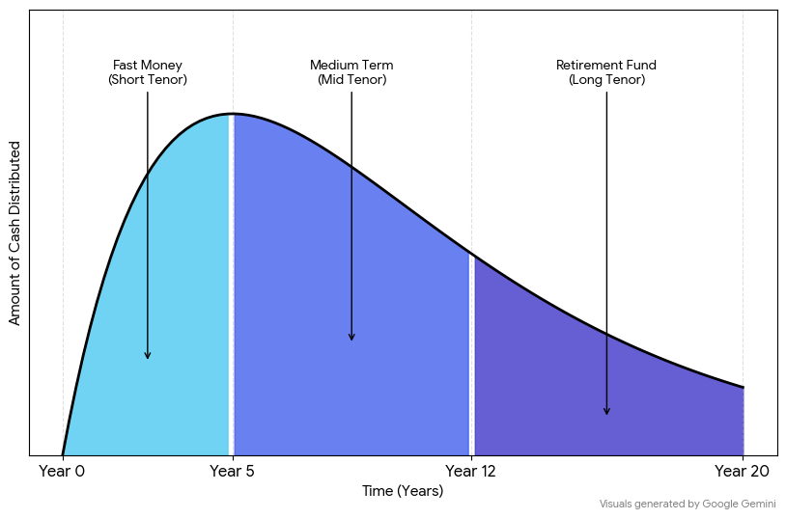
What Financial Markets Do...
You are a bank with 1000 mortgages on your books — some householders will pay off quickly, some will plod through exactly as on the original offer to the very end, and some … will fail to pay much at all.
Some in the financial markets want the low-risk early money, pension funds may want longer-term to match pay-outs for their long-lived pensioners, and some are happy to take risky stuff for a better interest rate.
Slice and dice, CMO derivatives...

Slide 7
Peak Shaving vs Dynamic Flexibility
Static response to shave peaks and avoid some grid building: move your power use away from evening and morning peaks by setting your heating and hot water programmer once.
Dynamic response: when there is less sun or wind than forecast on the day or during 'Dunkelflauten', just let your laundry basket pile up or run a cold(er) wash or turn the heating down a degree!
Electricity is already half price or less if you can do these, with a smart meter, and a battery can help.

Slide 8
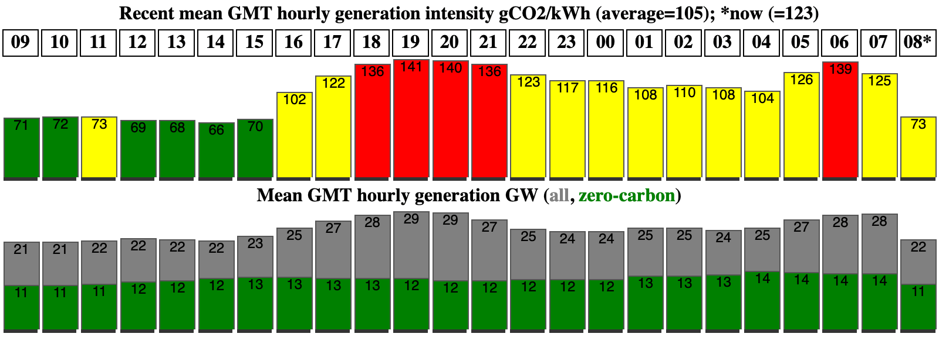
GB Grid Intensity
When you use electricity also determines how much carbon emissions are produced, though the CP2030 plan aims to make that near zero by 2030.
At peak times typically more expensive and inefficient fossil fuel generators are run. Another reason to shave peaks!

Slide 9
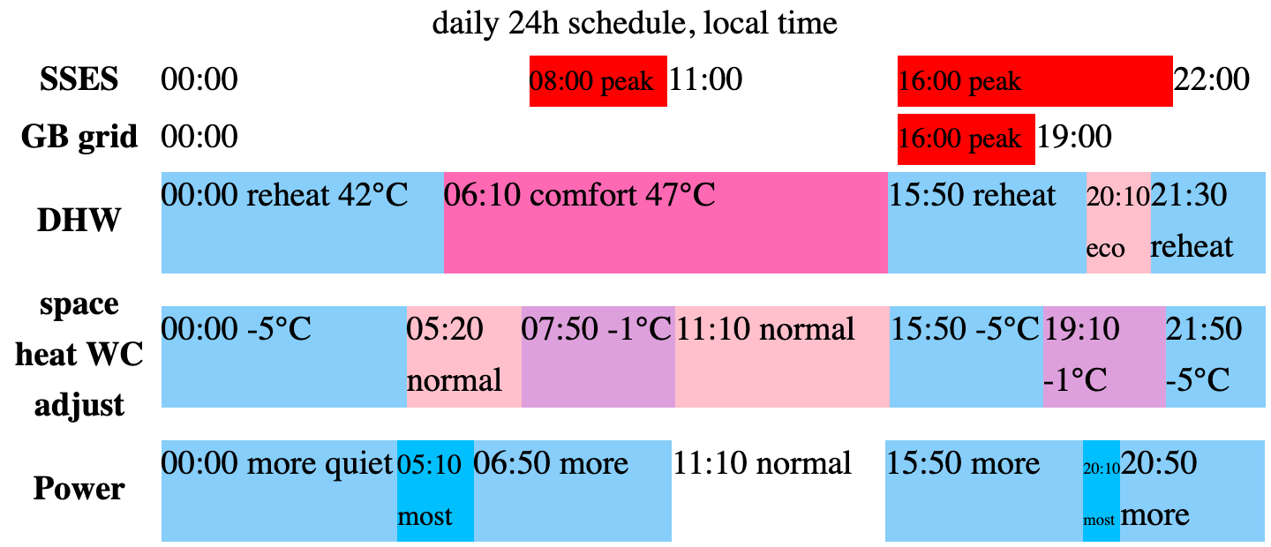
What I Have Done: Static
Static: shifted my heat pump hot water times away from peaks.

Slide 10
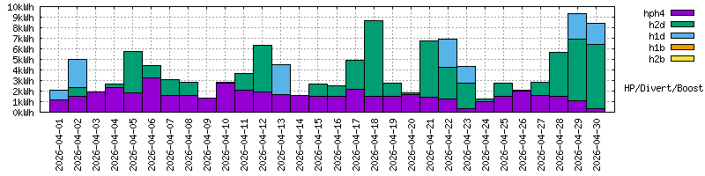
What I Have Done: Dynamic
Dynamic: top up directly from solar PV when there is lots of green energy on the grid.

Slide 11

What You Can Do Tonight, Free!
Program your heating off 5pm to ~7pm and coast, even for gas!
Don't run the dishwasher just after your evening meal: 4am or noon is better!
(GB SSES 'off-peak' times are 10pm to 8am, 11am to 4pm.)
You don't need to be content with a warm feeling inside: various Time of Use tariffs will pay you to do this, eg Octopus Agile or EDF FreePhase.

Slide 12
Summary
This complicated distributed puzzle has a piece-by-piece solution.
You can be part of that solution and bank your good behaviour.
Damon Hart-Davis d.hart-davis@surrey.ac.uk and d@hd.org
Web: earth.org.uk

